Slide 1
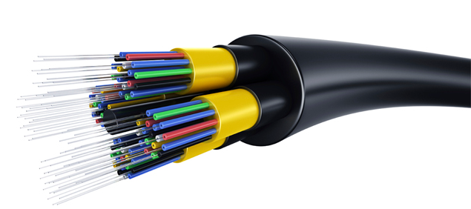
Fiber Optic Communication Systems
Lec # 01

Slide 2
Introduction
Title: Fiber Optic Communication Systems
Credit Hours: 3+1
Semester: 7th
Course Teacher: Professor Dr. Monir Morshed

Slide 3
Recommended Book:
Fiber Optic Communications by Joseph C. Palais, Latest Edition.
Reference Books:
Optical Fiber Communications: Principles and Practice by John M. Senior, Latest Edition, Prentice Hall.
Optical Fiber Communications by Gerd Keiser, Latest Edition, McGraw Hill.
Fiber-Optic Communication Systems by Govind P. Agrawal

Slide 4
Objective
To realize the significance of optical fiber communications.
To understand the construction and characteristics of optical fiber cable.
To develop the knowledge of optical signal sources and power launching.
To identify and understand the operation of various optical detectors.
To under the design of optical systems and WDM.

Slide 5
Course Contents
Overview
Historical perspectives
The basic communication systems
Nature of light
Advantages of light
Application of fiber optic communications
Optics Review
Ray theory and applications
Lenses
Imaging
Numerical aperture
Diffraction

Slide 6
Course Contents cont…
Lightwave Fundamentals
Electromagnetic waves
Dispersion, pulse dispersion and information
Polarization
Critical angle Reflections
Optic Fiber Waveguide
Step-index Fiber
Graded-index fiber
Attenuation
Pulse distortion and information rate in optic fiber
Construction of optic fiber
Optic fiber cables

Slide 7
Course Contents cont…
Light Sources
Light emitting diodes
Light emitting diodes operating characteristics
Laser principles
Laser diodes
Laser diodes operating characteristics
Distributed Feed-back Laser diodes
Optical Amplifiers
Vertical-Cavity Surface-Emitting Laser (VCSEL) Diodes
Light Detectors
Principles of photo-detection
Semiconductor photo diodes
PIN photodiodes
Avalanche Photodiodes

Slide 8
Course Contents cont…
Couplers and Connectors
Connector Principles
Splices
Connectors
Source Coupling
Distributed Networks and fiber components
FDDI, SONET, ATM,SDH,WDM
Fiber Bragg Gratings
Other components
PON
Noise and Detection
Thermal and shot noise
Signal to noise ratio
Error rates
Mode-noise, Mode partition noise, Amplifier noise, Laser noise and jitter
Additional noise contributor
Receiver circuit design

Slide 9
Course Contents cont…
Systems Design
Analog Systems design
Digital systems design
DWDM Filters
Fiber Grating Filters
Fabry Perot Filters
Multilayer Dielectric Thin-Film Filters
Mach-Zehnder Interferometers
Photonic Networks

Slide 10
Tentative Grading Policy
Attendance 10%
CT 20%
Final Paper 70%
Lab Report 20%
Lab Attendance 10%
Quiz 20%
Lab Final 50%

Slide 11
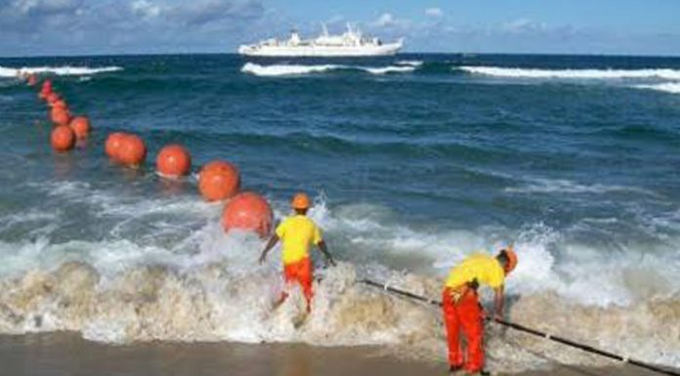
Why is this course useful to you?
Perhaps the most obvious answer is to consider the social impact of optical communications.
In 1966, two engineers at Standard Telecommunication Laboratories in England wrote a paper which in essence started the race to develop optical fiber for communications:

Slide 12
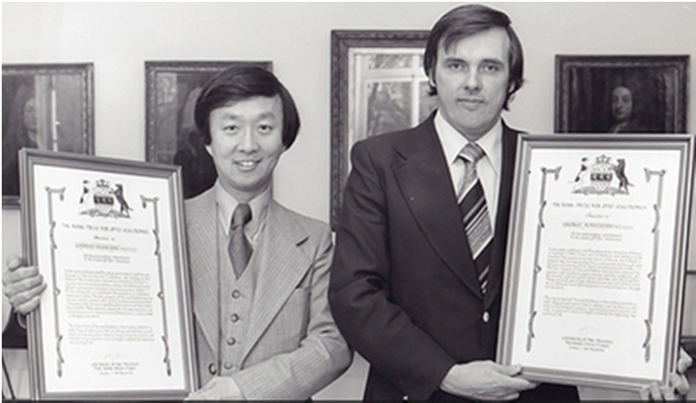
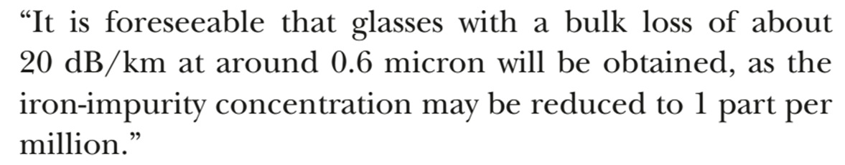
Why is this course useful to you?
One year later, the Philco-Ford company tried to predict the future; they were in many ways very close to what we have. (https://www.youtube.com/watch?v=rpq5ZmANp0k)

Slide 13
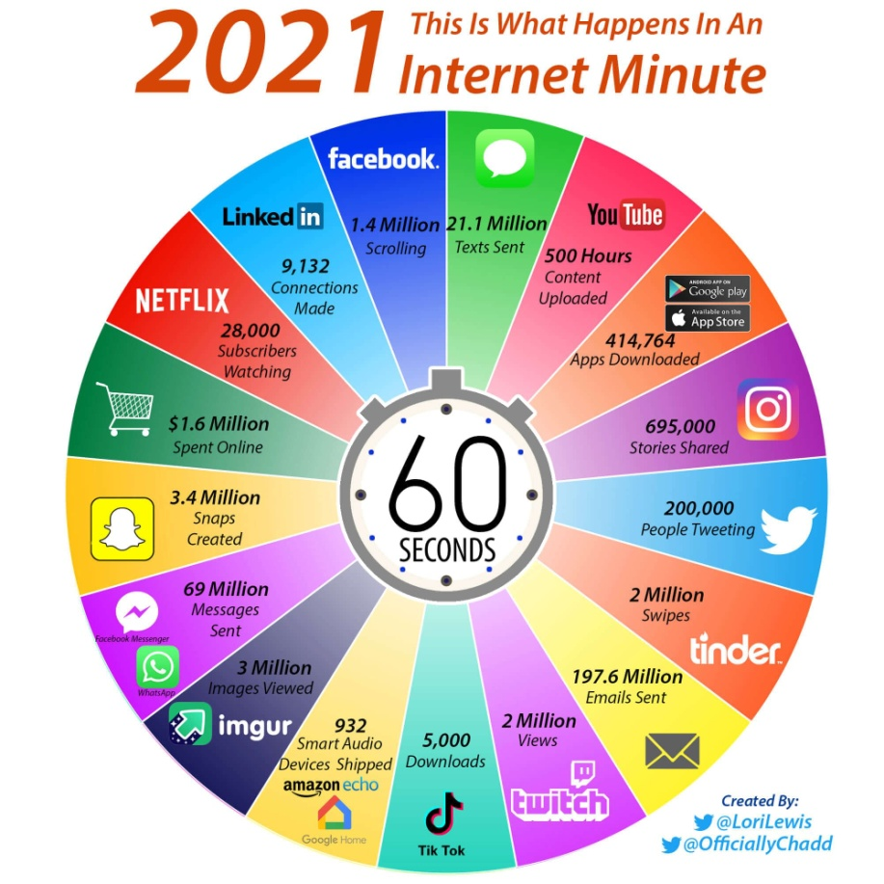
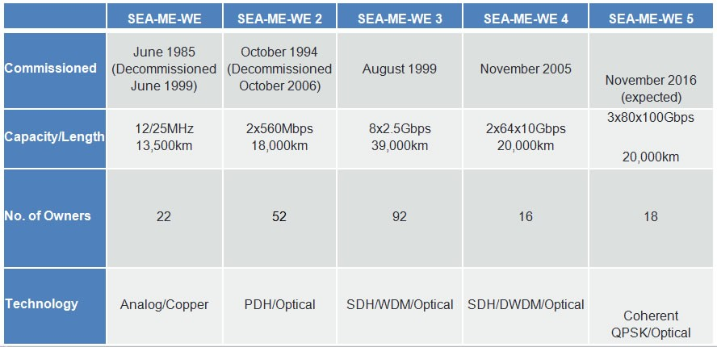
What happens in an 2021 INTERNET MINITUE?
All of this is made possible by a global infrastructure of optical cables

Slide 14
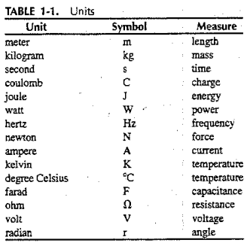
Numbers
Some basic Units that may appear frequently in this course are listed in following table for convenient reference

Slide 15
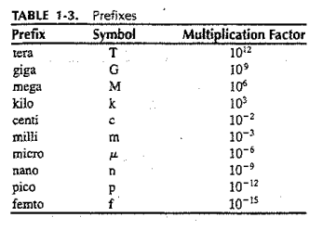
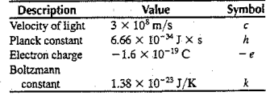
Constants & Prefixes
A few important constants and prefixes that will need to study our course.

Slide 16
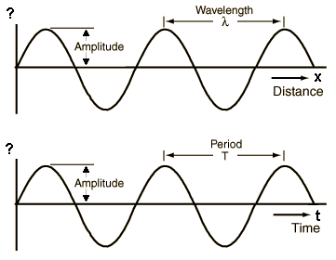
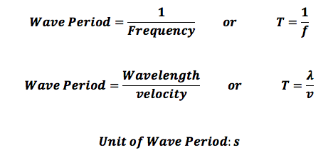
Frequency & Period
The frequency unit, the hertz, is equivalent to one cycle of oscillation per second .
The time between successive peaks of an oscillation is called the period.
If f is the wave frequency and T is its period then T=1/f.

Slide 17
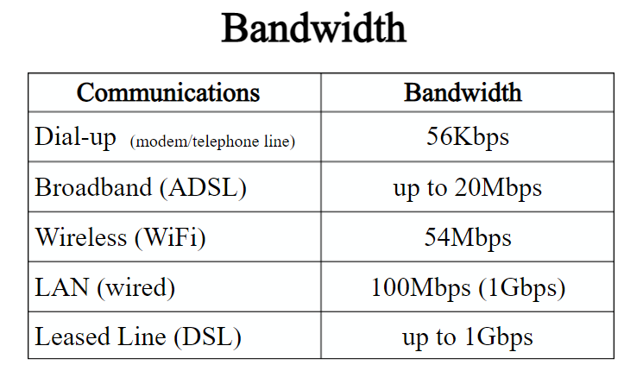
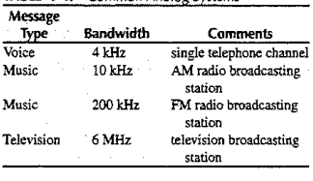
Bandwidth requirement for Common Analog Systems
Following Table, summarizes the bandwidth requirements of several analog systems.
Bandwidth:
Bandwidth is a maximum transmission rate of a communications channel.
Measure in bits per second (bps)
Kbps, Mbps, Gbps
A measure of the capacity of communication channel

Slide 18
Sampling
When analog signals are transmitted digitally, the bit rate depends on the
rate at which the analog signal is sampled
the coding scheme.
Why the standard 4-kHz telephone channel is sampled 8000 times a second?
To transmit the signal accurately, the signal should be sampled at a rate of at least twice the highest frequency contained in that signal.
For this reason the standard 4-kHz telephone channel is sampled 8000 times a second.
The coding procedure uses 8 bit to present amplitude of each sample
So a single telephone message needs 64,000 bps.

Slide 19
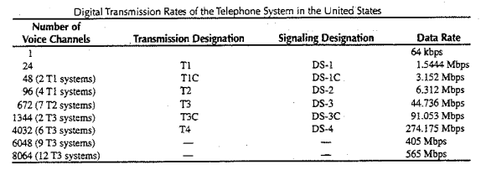
Data Rates of the Telephone Systems in the USA
A single voice channel needs 64 Kbps.
A T1 line can carry 24 voice channels or digital data rate of 1.544 Mbps.
Traditional T1 line use 2 twisted pair copper wires.
A T1 line can transmit data at a speed of 1.544 Mbps

Slide 20
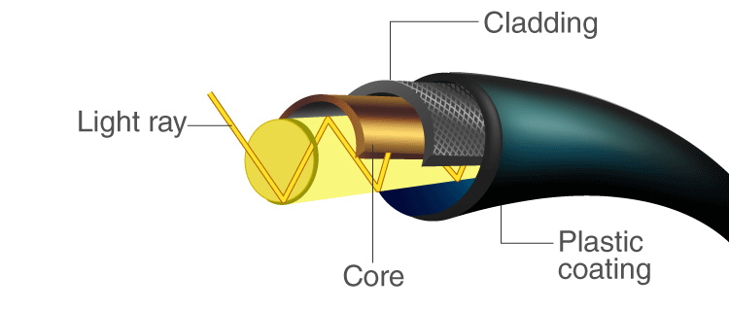
Introduction
Fiber-optic communication:
It is a method of transmitting information from one place to another by sending pulses of light through transparent waveguides.
The transparent waveguides are made of plastic or glass.
An optical fiber is a very thin strand of plastic or glass that is used to transmit messages via light
The light forms an electromagnetic carrier wave that is modulated to carry information.

Slide 21
Introduction
Why optical fiber is preferred :
High bandwidth
Long distance
Immunity to electromagnetic interference required
It can transmit voice, video, and telemetry through LAN, computer networks, or across long distances.
Application of optical fiber:
Medical: imaging tools, as laser for surgeries
Defense/Government: Used as hydrophones for seismic waves and SONAR
Data storage
Telecommunications
Networking
Broadcast/CATV

Slide 22
Historical Development
First generation (Graded-index fibers):
Year implemented: 1980
Bit rate: 45 Mb/s
Repeater spacing: 10 km
Operating wavelength: 0.8 um
Semiconductor: GaAs
Second generation (Single-mode fibers):
Year implemented: 1985
Bit rate: 100 Mb/s to 1.7 Gb/s
Repeater spacing: 50 km
Operating wavelength: 1.3 um
Semiconductor: In GaAsP

Slide 23
Historical Development
Third generation (Single-mode lasers):
Year implemented: 1990
Bit rate: 10 Gb/s
Repeater spacing: 100 km
Operating wavelength: 1.55 um
Fourth generation (Optical amplifiers):
Year implemented: 1996
Bit rate: 10 Tb/s
Repeater spacing: > 10,000 km
Operating wavelength: 1.45 um to 1.62 um
Fifth generation (Raman amplification):
- Year implemented: 2002
- Bit rate: 40 Gb/s to 160 Gb/s
- Repeater spacing: 24,000 km to 35,000 km
- Operating wavelength: 1.53 um to 1.57 um

Slide 24
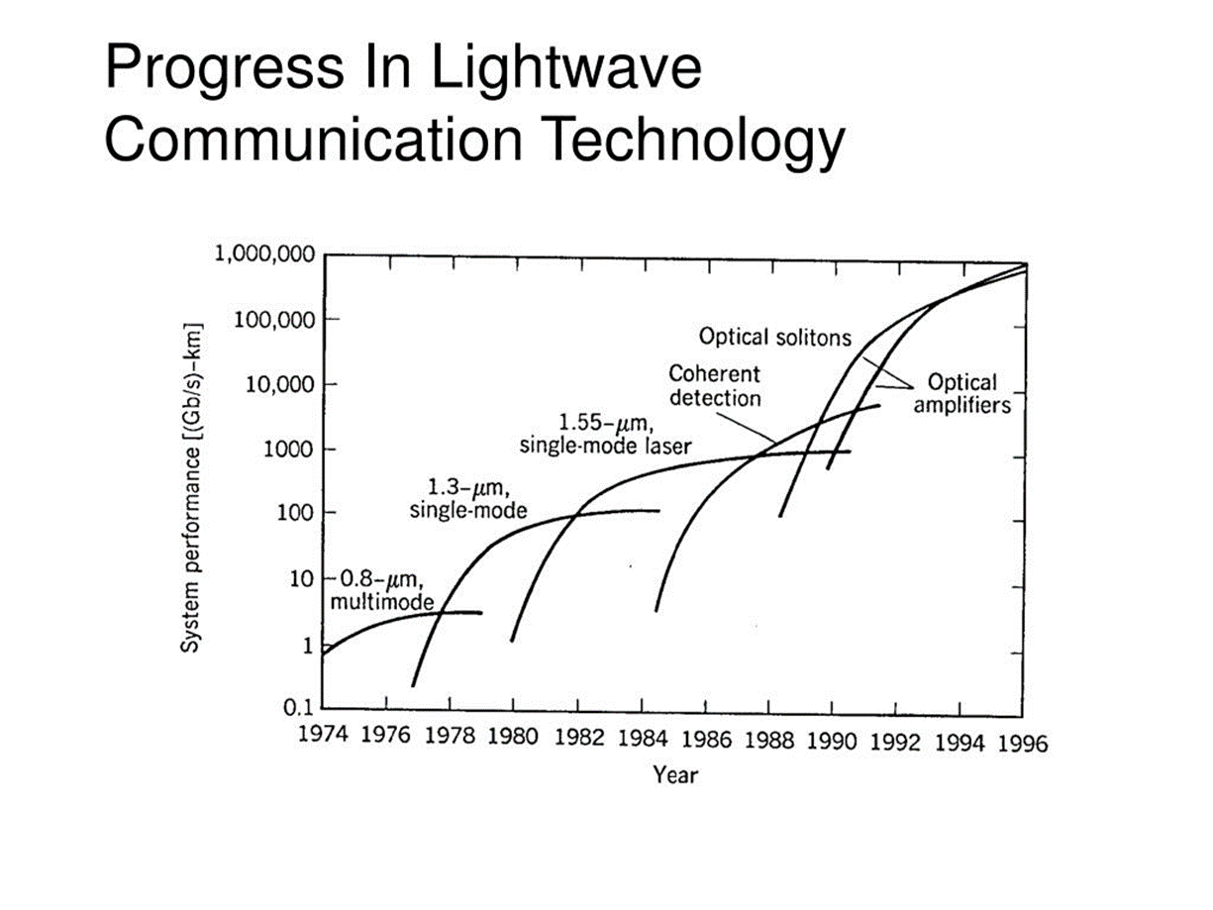
Progress in Lightwave Communication Technology

Slide 25
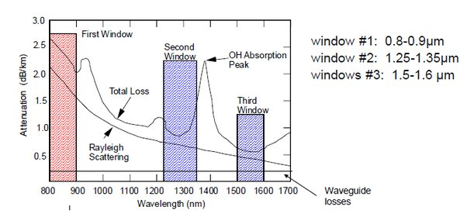
Transmission loss of silica fiber and optical communication wavelength bands

Slide 26
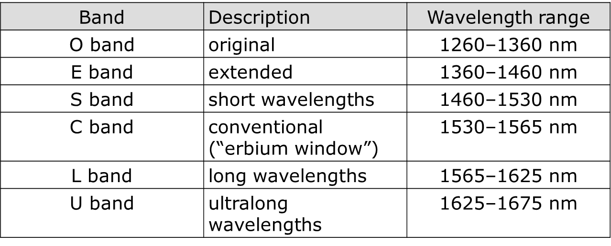
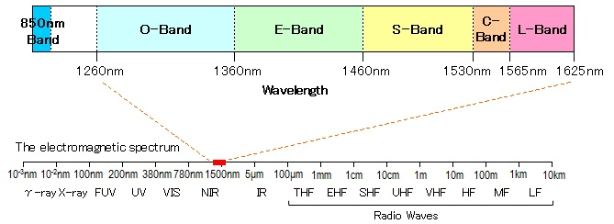
Electromagnetic spectrum & optical communication wavelength bands

Slide 27
General OFC System
Basic block diagram of optical fiber communication system consists of following important blocks:
Transmitter
Information channel
Receiver
Transmitter
Information Channel
Receiver
Repeater
Optical
Detector
Channel
Coupler
Optical fiber
Carrier
Source
Amplifier
Message origin (Text/Video)
Modulator
Processing
Message Output
Fig. Block diagram of OFC systems

Slide 28
General OFC System
Message origin:
It is transducer convert non-electrical message to electrical signal.
e.g., microphone, video camera
Modulator:
It converts the electrical message into proper format.
It impresses this signal onto the wave generated by the carrier source.
Two distinct categories of modulation are used i.e. analog modulation and digital modulation.
Carrier source:
Carrier source generates the wave on which the information is transmitted
For fiber optic system, a laser diode (LD) or a light emitting diode (LED) is used.

Slide 29
General OFC System
Channel coupler:
Coupler feeds the power into the information channel
Generally, lens are used as a channel coupler.
The lens collimates the light emitted by the source and directing this light towards the receiver through fiber.
Information channel:
The information channel is the path between the transmitter and receiver.
A glass or plastic fiber is used as a information channel.
The channel attenuation should be low and large light acceptance angle.
Repeater are used to regenerate weak and distorted signal.
Another property of channel is propagation time. The signal in a channel contains different optic frequencies and divide its power along several ray paths, that cause pulse spreading.

Slide 30
General OFC System
Optical detector:
In the fiber system the optic wave is converted into an electric current by a photodetector.
The important properties of photodetectors are small size, economy, long life, low power consumption, high sensitivity to optic signals and fast response to quick variations in the optic power.
Signal processing:
Signal processing includes filtering, amplification.
Proper filtering maximizes the ratio of signal to unwanted power.
For a digital system, the BER should be small.
Message output:
The electrical form of the message emerging from the signal processor is transformed into a sound wave or visual image.
Sometimes these signals are directly usable when computers or other machines are connected through a fiber system.

Slide 31
Elements
Source & Modulators
LED, LD etc.
Multiplexers & Demultiplexers
WDM, DWDM etc.
Amplifiers or Repeaters
Connectors, Couplers, Isolators, etc.
Detectors & Demodulators
PD, APD, PIN etc.
End Mile Networks

Slide 32
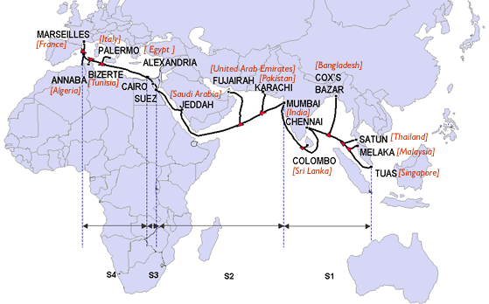
SEA-ME-WE
South East Asia–Middle East–Western Europe 4 (SEA-ME-WE 4) is an optical fibre submarine communications cable system that carries telecommunications between Singapore, Malaysia, Thailand, Bangladesh, India, Sri Lanka, Pakistan, United Arab Emirates, Saudi Arabia, Sudan, Egypt, Italy, Tunisia, Algeria and France.^{[1]} It is intended to be a complement to, rather than a replacement for, the SEA-ME-WE 3 cable. The cable is approximately 18,800 kilometres long, and provides the primary Internet backbone between South East Asia, the Indian subcontinent, the Middle East and Europe

Slide 33




History of SEA-ME-WE
South-East Asia - Middle East - Western Europe
1986, the first cable of the SEA-ME-WE series (SEA-ME-WE 1) was constructed using a coaxial cable designed to transmit telephone signals between Europe, the Middle East and Southeast Asia.
It was the longest telephone cable in the world spanning 13,585 km, and was the first cable to be laid in the Indian Ocean.
The maximum bandwidth of the cable was calculated to be 25 MHz
Due to higher demands of broadband and data transfer, leading to the construction of the
SEA-ME-WE 2, 3 and 4 projects.

Slide 34






SEA-ME-WE 2

Slide 35


SEA-ME-WE 2
South-East Asia - Middle East - Western Europe 2.
The SEA-ME-WE 2 project was installed on October 18th, 1994.
A fiber optic cable system, spanning 18,751 km, linking 13 countries and three continents.
Peak capacity of the cable was 560 Mbps, which is approximately equal to the capacity of fifteen SEA-ME-WE 1 cables.

Slide 36

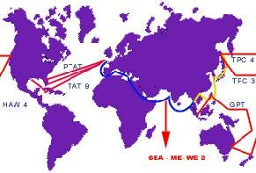
SEA-ME-WE 2 Route
13/12/2009
6

Slide 37




Introduction To SEA-ME-WE 3
SEA-ME-WE 3
South-East Asia - Middle East - Western Europe 3.
optical submarine telecommunication cable link and is the longest in the world stretches from North Germany to Australia and Japan.
completed in late 2000.

Slide 38

Introduction …
led by France Telecom and China Telecom, and is administered by SingTel.
telecommunications operator owned by the Government of Singapore.
Total length 39,000 kilometers (24,000 mi).

Slide 39


Technology used in SEA-ME- WE 3
Wavelength Division Multiplexing (WDM) technology is for transmission to increase capacity and enhance the quality of the signal, especially over long distances.
WDM is a technology which multiplexes a number of optical carrier signals onto a single optical fiber by using different wavelengths (i.e. colors) of laser light.

Slide 40






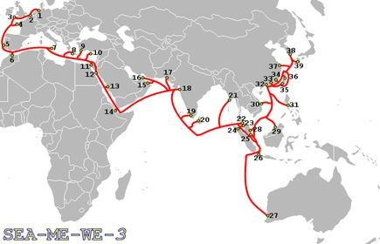
Route and landing points SEA-ME- WE 3

Slide 41



Landing points of SEA-ME-WE 3
39 landing points:
Norden, Germany
Oostende, Belgium
Goonhilly, England, UK
Penmarch, France
Sesimbra, Portugal
Tetuan, Morocco
Mazara del Vallo, Italy
Chania, Greece
Marmaris, Turkey
Yeroskipou, Cyprus
Alexandria, Egypt
Suez, Egypt
Jeddah, Saudi Arabia
Djibouti, Djibouti
Muscat, Oman
Fujairah, United Arab Emirates
Karachi, Pakistan
Mumbai, India
Cochin, India
Mount Lavinia, Sri Lanka

Slide 42

Landing points…
Pyapon, Myanmar
Satun, Thailand
Da Nang, Vietnam
Batangas, Philippines
23. Penang, Malaysia
(Where it meets the 32. Taipa, Macau
SAFE and the FLAG cables.)
Medan, Indonesia
Tuas, Singapore
Jakarta, Indonesia
Perth, Australia
Mersing, Malaysia
Tungku, Brunei
Deep Water Bay, Hong Kong
Shantou, China
Fangshan, Taiwan
Toucheng, Taiwan
Shanghai, China
Keoje, South Korea
Okinawa, Japan

Slide 43

SEA-ME-WE 4

Slide 44

SEA-ME-WE 4
South East Asia-Middle East-West Europe 4 (SEA-ME-WE 4)
It is the fourth project in the SEA-ME- WE series. On 27th March 2004.

Slide 45




SEA-ME-WE 4 …
an optical fiber submarine communications cable.
carries telecommunications between Singapore, Malaysia, Thailand, Bangladesh, India, Sri Lanka, Pakistan, United Arab Emirates, Saudi Arabia, Sudan, Egypt, Italy, Tunisia, Algeria and France.

Slide 46




History of SEA-ME-WE 4
SEA-ME-WE 4 cable system was developed by a consortium of 16 telecommunications companies which agreed to construct the project on 27 March 2004.
Construction of the system was carried out by Alcatel Submarine Networks
project was completed on 13 December 2005 with a cost estimate of US$500 million

Slide 47


Network topology used in SEA-ME-WE 4
The SEA-ME-WE 4 system is divided into four segments with seventeen landing points:
Segments
S1 - Tuas to Mumbai S2 - Mumbai to Suez S3 - Suez to Cairo
S4 - Cairo to Marseille

Slide 48





Countries linked through
SEA-ME-WE 4
Bangladesh
India
Pakistan
Sri-Lanka
Thailand
Malaysia
Singapore
United Arab Emirates
Sudan
Egypt
Italy
Tunisia
Algeria
France
Saudi Arabia

Slide 49






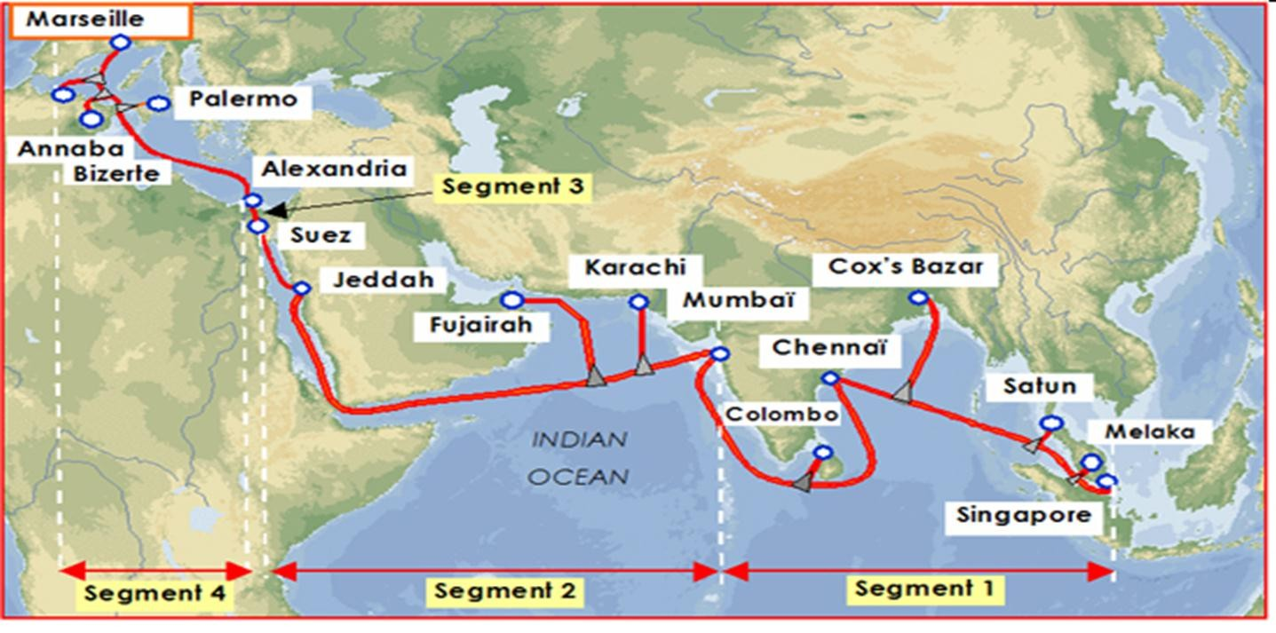
Connecting Point of SEA-ME- WE 4

Slide 50


Length of SEA-ME-WE 4
The cable is approximately 18,800 kilometers long.
provides the primary Internet backbone between South East Asia, the Indian subcontinent, the Middle East and Europe.

Slide 51

Technology used in SEA-ME- WE 4
Uses wavelength-division multiplexing WDM, allowing increased communications capacity per fiber.
It also facilitates bidirectional communication within a single fiber.

Slide 52





Advantages of SEA-ME-WE 4
SEA-ME-WE-4 is used to carry telephone, internet, multimedia, broadband data.
SEA-ME-WE 4 has a faster rate of data transmission at 1.28 Tbit/s against SEA-ME- WE 3's 10 Gbit/s
SEA-ME-WE 3 provides connectivity to a greater number of countries over a greater distance, but SEA-ME-WE 4 provides far higher data transmission speeds intended to accommodate increasing demand for high- speed internet access in developing countries

Slide 53









Comparison Between SEA-ME-
WE 1
and SEA-ME-WE 2
SEA-ME-WE 1
SEA-ME-WE 2
coaxial cable designed to transmit telephone signals.
length13,585 km.
maximum bandwidth of the cable was 25 MHz
fiber optic cable system.
18,751 km, linking 13 countries.
capacity of the cable was
560 Mbps.

Slide 54


Comparison Between SEA-ME-
WE 3
and SEA-ME-WE 4
SEA-ME-WE 3
SEA-ME-WE 4
SEA-ME-WE 3 cable was completed with a capacity of 2.5 Gbps, which was later upgraded to 10 Gbps in 2002.
Total length 38,000 km.
Total length 20,000 km.
Capacity of 1.28 Tbps,

Slide 55
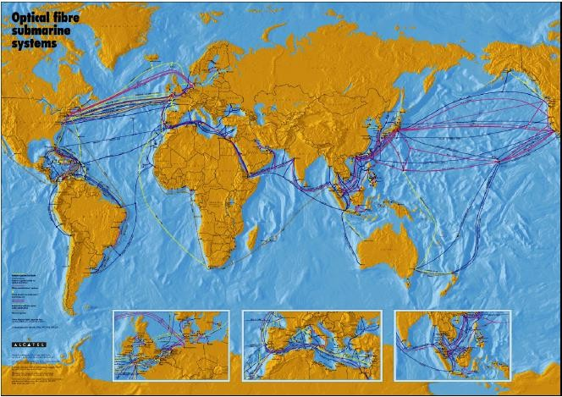
SEA-ME-WE 5 SUBMARINE CABLE HISTORY
 | SEA-ME-WE | SEA-ME-WE 2 | SEA-ME-WE 3 | SEA-ME-WE 4
Commissioned in | June 1985 (Decommissioned June 1999) | October 1994 (Decommissioned October 2006) | August 1999 | November 2005
Capacity/Length | 12MHz 13,500km | 2x560Mbps 18,000km | 8x2.5Gbps 39,000km | 64x2x10Gbps 20,000km
No. of Owners Total Investment | 22 USD800M | 52 USD800M | 92 USD1500M | 16 USD500M
Technology | Analog/Copper | PDH/Optical | SDH/WDM/Optical | SDH/DWDM/Optical
eston dda ot kciCl
edyolepD e
sbl Ca enirambuS fo paM eltaclA

Slide 56
ABOUT SEA-ME-WE 5
•
•
•
•
•
•
•
Matchless, PoP to PoP, multi-regional data superhighway
20.000 km submarine cable system connecting Southeast Asia to Western Europe
Further enhancing the diversity and resilience to the heavily loaded Asia
to Europe route
Latest 100Gbps technology enabling initial system capacity of 24 Tbps
High level of flexibility for consortium members in utilizing their
capacity entitlement
Lowest latency
Ready for service: Q4 2016

Slide 57
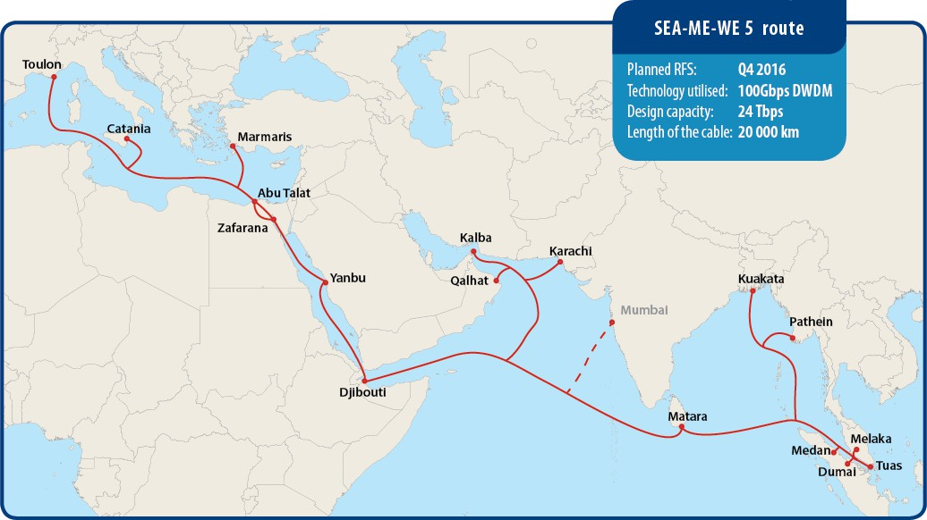
SEA-ME-WE 5 ROUTE

Slide 58
ADVANTAGES
•
•
•
•
•
•
•
•
Established by industry leading operators with extensive experience in submarine cable projects.
Consortium’s proven track record of delivering results from successful
completion of previous SEA-ME-WE projects.
Financially stable - fully secured financing.
Strong commitment by all participating parties.
Leading-edge technical know-how of its consortium members.
Open system with free access to carrier neutral, international PoPs belonging to the core of SEA-ME-WE 5.
Solid design and well-founded project plan which has been followed
without any deviation to date.
The spans of the system are optimized for future upgradability.

Slide 59
POPs and CROSS CONNECTION POSSIBILITIES
•
The core system includes fully protected terrestrial extensions to major carrier-neutral PoPs. The list of the main PoPs which are connected to SEA-ME-WE 5:
Marseille: Interxion (formerly Net Center) and/or Jaguar
Palermo: New carrier neutral Sicily Hub PoP
Singapore: Equinix, Global Switch
SEA-ME-WE 5 will also secure outstanding cross connection possibilities with other submarine cables in Egypt, Saudi Arabia, Djibouti and Sri Lanka.
Marmaris CLS in Turkey will also be opened without extra costs for members to increase the options for terminating capacities in Europe.
•
•

Slide 60
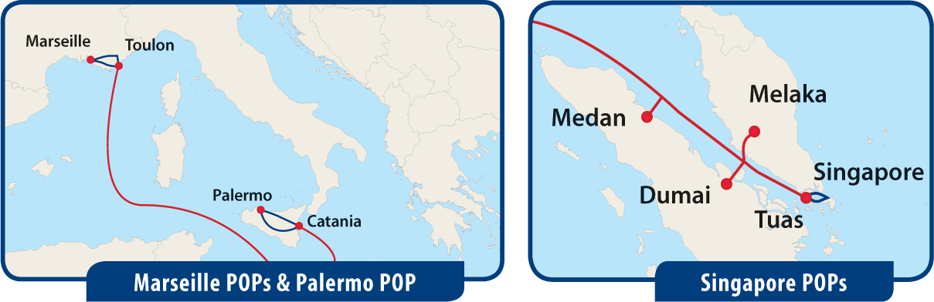
SEA-ME-WE 5 POPs

Slide 61
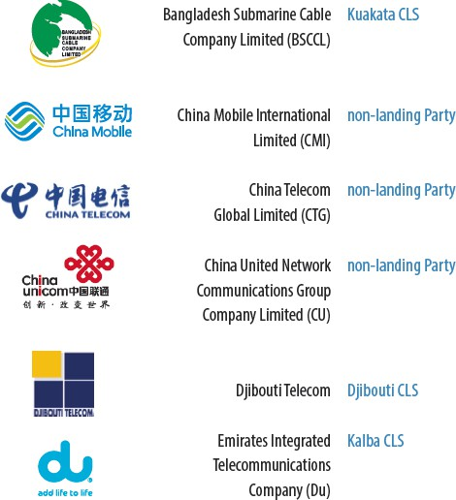
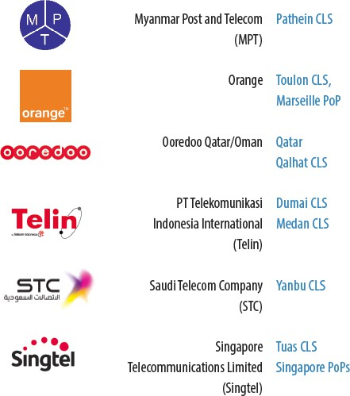
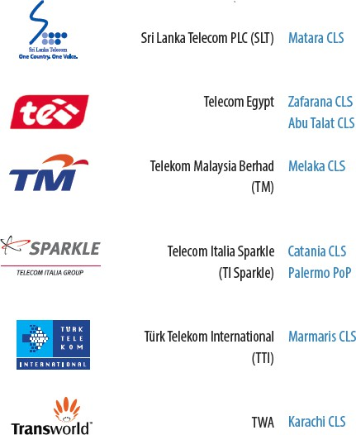
CONSORTIUM MEMBERS AND THEIR CABLE LANDING STATIONS

Slide 62
SEA-ME-WE 5 ROUTE

Slide 63
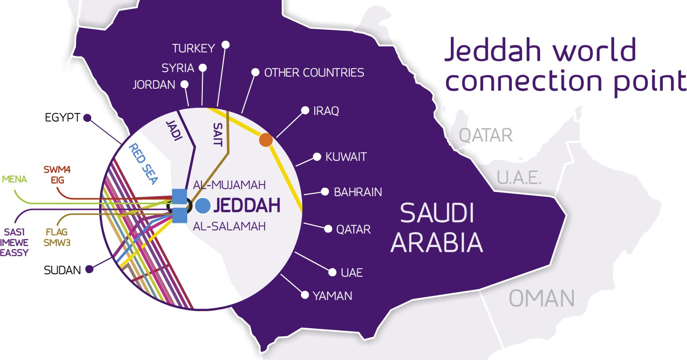


JEDDAH CABLE LANDING STATION (CLS)
YEMEN

Slide 64
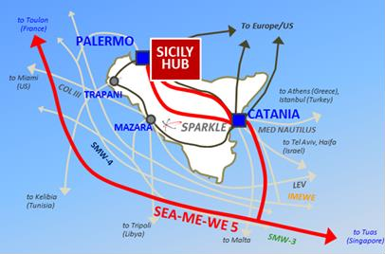
Catania CLS and
Palermo PoP
ITALY LANDING
in ITALY
12

Slide 65
SEA-ME-WE 5 ROUTE

Slide 66
Advantages of Optical Fiber
Advantages of OFC:
Extremely high bandwidth:
Longer distance: Typically, it is less than 1dB/km.
Immune to cross talk
Resistance to electromagnetic interference
Low security risk
Small size
Light weight
Greater flexibility
Easy accommodate increasing bandwidth

Slide 67
Disadvantages of Optical Fiber
disadvantages of OFC:
High initial cost
Maintenance and repairing cost
Jointing and test procedures
Tensile stress
Fiber losses

Slide 68
Computing power levels
(decibels)
To design an optical fiber communication systems, it is important to account the optical power.
This power measurement helps to ensure that incident wave on the detector has sufficient strength to be clearly and correctly recognized.
In other instances the received power may even be too large for the receiver.
The designer must be certain this does not occur.
If the power is P₁ watts at one point in the system and P₂ watts at some point farther along the link, then P₂/P₁ is the fraction of the power transmitted between the two locations
dB=10 log₁₀P₂/P₁
or, P₂=P₁ 10 ^{dB/10}

Slide 69
Decibels (dB) Calculation
If we consider power levels in a cascaded system of the following figure:
P₂
P₃
P₁
P₄
The output power is determined by:
The logarithmic scale is used to ease with which total change in power level is found when several elements are cascaded:

Slide 70
Example
Suppose that the three elements in the following figure have losses -11,-6 and -3 dB respectively. Find the total loss of the combination. Find the output power if the input power is 5mW.
P₂
P₃
P₁
P₄
Solution: The total loss is =-11-6-3=-20dB

Slide 71
Example
A system has -23 dB of loss. Compute its efficiency.
A light emitting diode radiates 2mW. Compute the dBm value of this radiated power. The power travels through a group of components having a combined loss of 23 dB. Compute the output power.

